Slide 1
林广和
2016年5月7日（初稿）

Slide 2
P1
Accept as /Nerd (P1 L6)
He would strap a shoe box of electronics to his waist and a small keyboard to his wrist and then put on a bulky headset with a small display monitor suspended in front of his left eye. … the other students … stopped staring at him and accepted him as jus another nerd.

Slide 3
P1
(continue)
Geek
Nerd: someone who is a technological expert but is socially unskilled.

Slide 4
P1
accept sb. /sth.as … :to think of sb./ sth. in a particular way 认为;以为;觉得
Thesaurus [ θɪˈsɔ:rəs ](同义词词典)
= consider sb./sth. as…
= see sb./sth. as…

Slide 5
P1
= regard/view … as …(a little more formal than see)
= perceive … as …(formal)
= think of … as…

Slide 6
P2
Miniature [ ˈmɪniəˌtʃʊr, -tʃɚ, ˈmɪnə- ] = mini (prefix)+ ature(P2L12)
What used to be big clunky devices only a nerd could love have now become miniature in size.

Slide 7
P2
mini-: very small or short, compared with others of the same kind
E.g:
miniwar小规模战争（mini + war 战争）
deminish 缩小的，减少的（de + mini 小+ ish→使…小→缩小）
minify使…缩小（mini + fy→小化）

Slide 8
P5
Stay/be in/out of tune with (P5L35)
Staying in tune with all that requires more than a handheld device, claim analysts at high-tech companies … .

Slide 9
P5
Meaning:一致/不一致;赞同/不赞同；If you are in tune with a group of people, you are in agreement or sympathy with them. If you are out of tune with them, you are not in agreement or sympathy with them.

Slide 10
P5
Today, his change of direction seems more in tune with the times...
今天，他方向的改变似乎更与时代合拍。
The peace campaigners were probably out of tune with most Britons.
和平倡导者可能不被大部分英国人认同。

Slide 11
P6
Be bound to (P6L49)
Teens say sensors that can relay this kind of information are bound to be big sellers.

Slide 12
P6
Meaning: 一定会；必然会；注定会 If you say that something is bound to happen, you mean that you are sure it will happen, because it is a natural consequence of something that is already known or exists.

Slide 13
P6
There are bound to be price increases next year...
明年物价一定会上涨。

Slide 14
Wearable Devices
Introduction
  Today users are moving towards a Multi Screen world where they have access to different form factors like that of notebooks, tablets and smart phones catering to their different needs. Wearable Devices are set to add a new dimension to this Multi Screen World

Slide 15
Android Wear
Android Wear is a customized Android Version for wearable devices like smart watches
Android Wear devices are powerful in terms of features and are also small enough to replace regular wristwatches

Slide 16
Android Wear
It provides contextual information based on users current environment and captures users behavior. Users can also view notifications and take action against each notification from their wearable devices

Slide 17
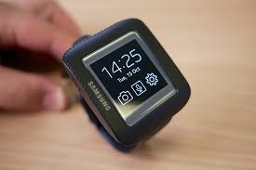
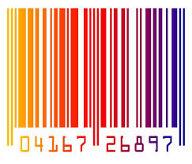
Use Cases
Phone Functions
    Read and Reply to SMS
    Read Notifications
    Set Alarm/Reminder
Digital Identity
    Boarding Pass
    Membership Cards
    Reservation Code
    Discount Coupon

Slide 18
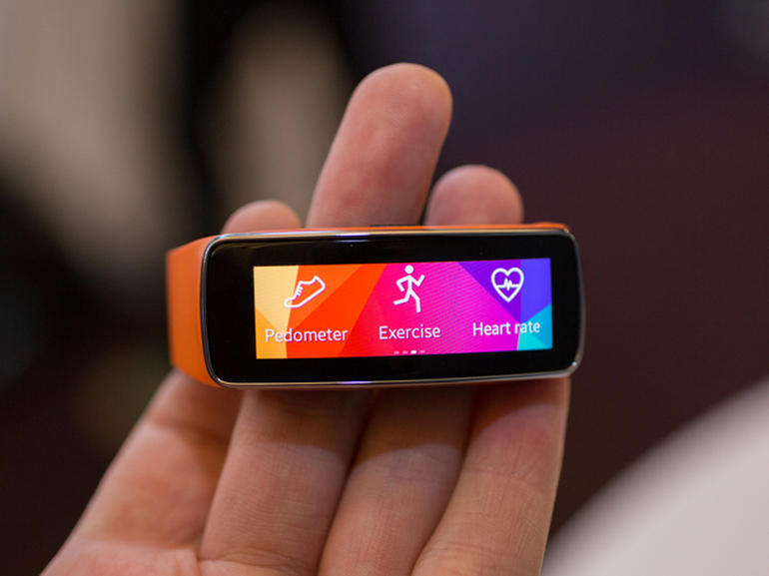
Fitness Tracking
  Calories Burned
  Distance Walked
  Blood Pressure
  Heart Rate
  Step Count etc.

Slide 19

Home Automation
  Open the garage door using your voice command
  Start any appliance by just giving voice command

Slide 20


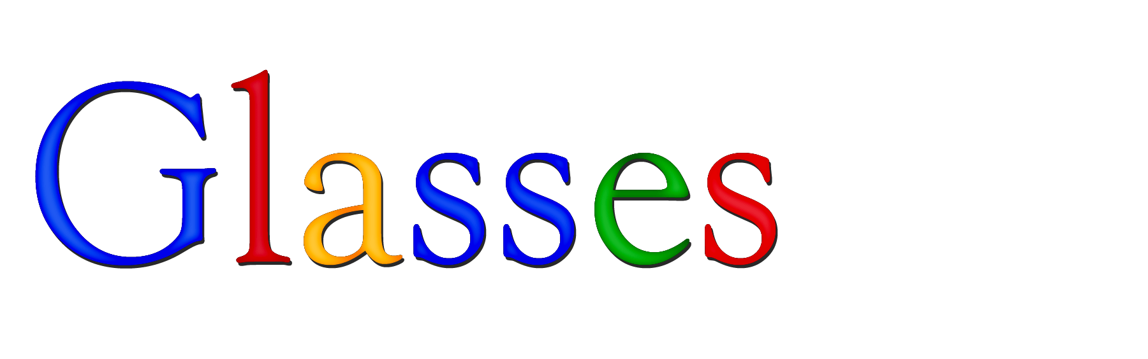
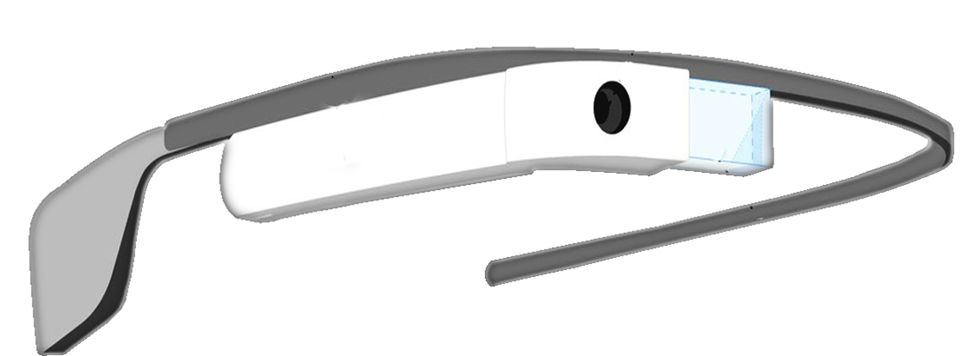

Slide 21
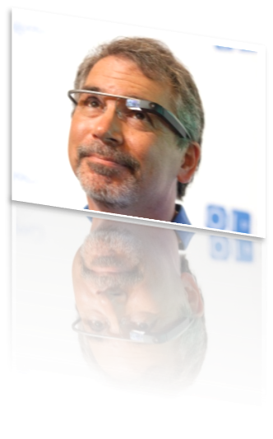
Introduction
Google Glass is a research and development program by Google for Head Mounted display (HMD).
The intended purpose of Google Glass would be the hands free displaying of information currently available to most smartphone users.

Slide 22
Advantages
Easy to wear and use.
Sensitive and responsive to the presence of people.
Fast access of maps, documents, videos, chats and much more.
A spectacle([ ˈspektəkl ]) based computer to reside directly on your eyes rather than in your pouch or pocket.

Slide 23
Disadvantages
Can be easily broken or damaged. Users will have a tough time taking care of it.
It may lead to accidents while driving.
Privacy of people may breach with new glasses.

